Slide 1
E(n) Equivariant Graph Neural Network
Authors: Victor Garcia Satorras, Emiel Hoogeboom, Max Welling

Slide 2
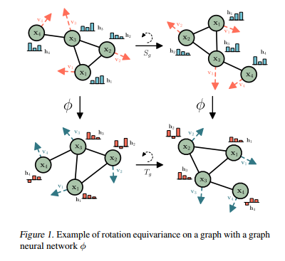
Introduction
The paper introduces E(n)-Equivariant Graph Neural Networks (EGNNs), a novel model for learning graph neural networks that are equivariant to rotations, translations, reflections, and permutations
Unlike existing methods, EGNNs do not require computationally expensive higher-order representations in intermediate layers
EGNNs are scalable to higher-dimensional spaces and perform competitively or better in various tasks such as dynamical systems modeling, representation learning in graph autoencoders, and predicting molecular properties

Slide 3
Background
Equivariance: Ensuring that a function applied to transformed data results in a correspondingly transformed output. This is important for maintaining the symmetry properties of the data
Graph Neural Networks (GNNs): Networks designed to operate on graph-structured data, maintaining permutation invariance of the nodes

Slide 4
Motivation
Problem: Existing Graph Neural Networks (GNNs) often lack equivariance to important transformations (rotation, translation, reflection, permutation)
Significance: Equivariance ensures that the neural network’s predictions are consistent under these transformations, which is crucial for tasks involving spatial data like 3D molecular structures and dynamical systems
Current Solutions: Existing methods often require complex, computationally expensive operations like spherical harmonics for achieving equivariance

Slide 5
EGNN Architecture
Equivariance in GNNs:
Translation Equivariance: The network handles translations in input space equivalently in the output space
Rotation and Reflection Equivariance: Uses orthogonal transformations to ensure rotations and reflections are properly managed
Permutation Equivariance: Maintains node order invariance
EGNN Layer:
Edge Operation: Considers relative squared distances between nodes
Coordinate Update: Positions are updated via a vector field in a radial direction, ensuring E(n) equivariance

Slide 6
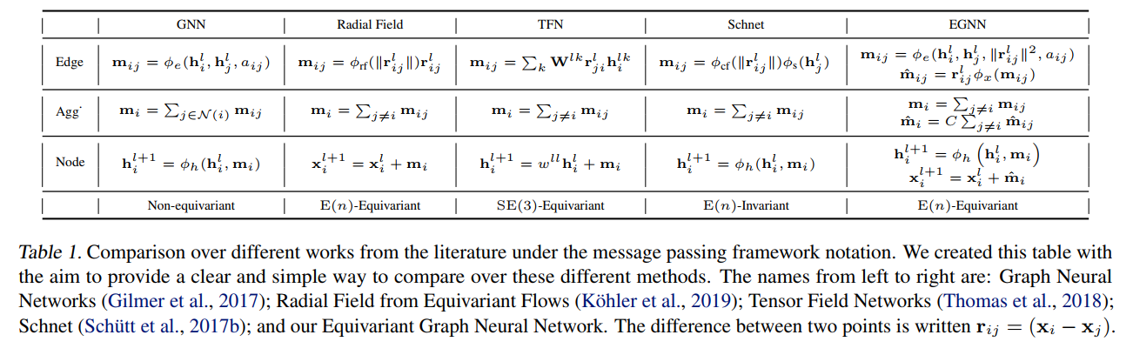
EGNN Architecture
The model incorporates both node embeddings and their coordinates, ensuring translation, rotation, and reflection equivariance
Equations defining the EGNN layer update node embeddings and coordinates, ensuring the model's equivariance properties
The paper provides a formal proof that the EGNN model maintains E(n) equivariance for both translation and rotation

Slide 7
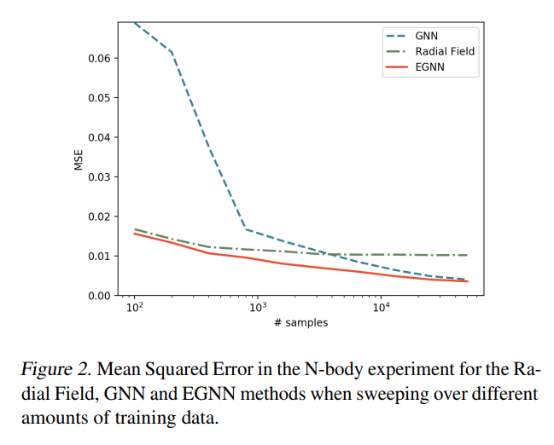
Experiments and results
Dynamical Systems Modeling (N-body Problem):
Forecast the positions for a set of particles which are modelled by simple interaction rules
Dataset: N-body system with 5 particles
EGNN outperformed other models like SE(3) Transformer, Tensor Field Networks, and standard GNNs in terms of accuracy and computational efficiency

Slide 8
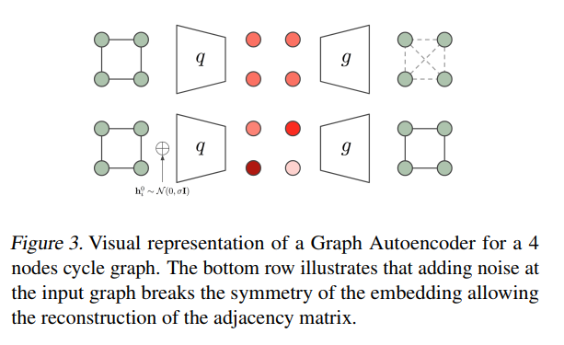
Experiments and results
Graph Autoencoder:
EGNNs were used to build an equivariant graph autoencoder
Dataset: Community Small and Erdos&Renyi graphs
The model successfully encoded and decoded graph structures, outperforming standard GNNs and radial field methods, especially in reconstructing sparse graphs

Slide 9
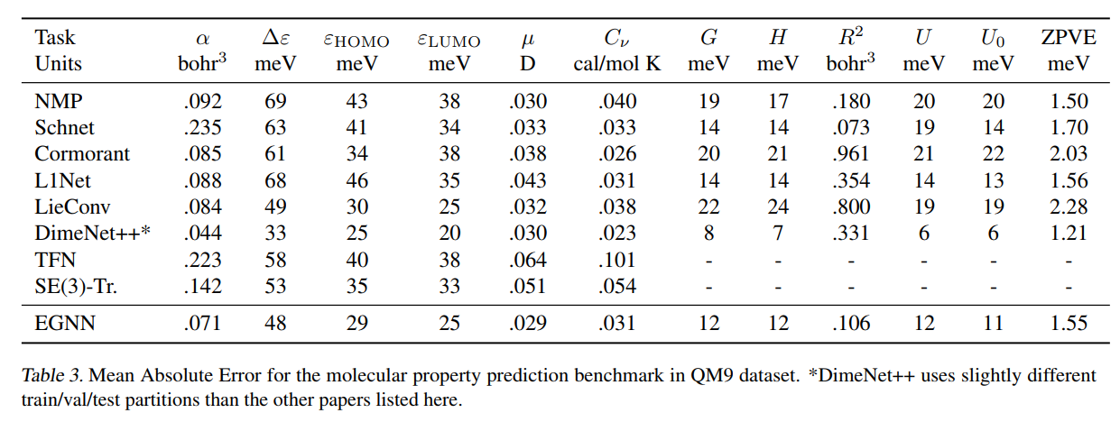
Experiments and results
Molecular Property Prediction (QM9 Dataset):
EGNNs were applied to predict various chemical properties of molecules
The model achieved competitive results compared to state-of-the-art methods while remaining computationally efficient

Slide 10
Conclusion
EGNNs represent a significant advancement in graph neural networks by combining simplicity, computational efficiency, and strong performance across multiple tasks
The model's ability to handle higher-dimensional spaces and maintain equivariance makes it particularly suitable for applications in natural and medical sciences, such as drug discovery and material design

